Slide 1
2024 MESM / PHD Computer Orientation
Bren Compute Team:
Brad Hill
Kat Le
Garrett Favre-Schwan
Cuddy Ritchason
Offices:
Main Help Desk: Bren 3516 (Office Wing)

Slide 2
Quick Show of Hands
Mac Laptop?
PC Laptop?
Happy with your laptop?
Logged into Canvas?
Installed and run Ivanti (VPN) from UCSB?
Have used Microsoft Remote Desktop?
Do you have MS Office installed?
Does fruit have any business being on Pizza?

Slide 3
Computer Accounts
UCSBnetID
UCSB Google Account
Google Email, Google Drive, etc.
Also called UCSB Connect account
Bren Desktop account
Login to Bren computers, REEF web portal, BREN-WIFI (Wi-Fi)
Password is assigned by Bren Compute Team and cannot be changed
Password is retrievable via a Google Sheet that is shared with you
Same username as UCSBnetID to make life easier, different password as it’s not tied into UCSBnetID system

Slide 4
UCSB Google Account and Email Addresses
Your UCSB Google Account has multiple Email Addresses:
UCSBnetID@ucsb.edu (Connect / Primary Address)
UCSBnetID@umail.ucsb.edu (uMail Alias)
UCSBnetID@bren.ucsb.edu (Departmental Alias)
You can receive email sent to any of these addresses
You can send email from any of these addresses
13 months after you graduate, UCSB deactivates your Google Account
We let you forward your @bren.ucsb.edu to a personal email address in perpetuity
Keep the above in mind when choosing an email address to create accounts

Slide 5
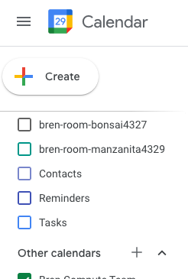
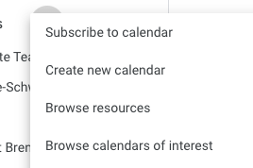
UCSB Google Resource Calendars
Resource calendars are associated with a thing and not a person.
General Use Calendars / Schedule
Equipment
Etc.
Example: Bren Events Calendar
bren-calendar-events

Slide 6
WiFi Options
BREN-WIFI (Wi-Fi) network
36 access points @ Bren
Good coverage throughout building
Good speed
Login with Bren Desktop Account
Hardwired locations available
EDUROAM WiFi network
11 access points @ Bren (Spottier)
Available across campus and participating institutions
Excellent speed
Login with UCSBnetID@ucsb.edu
Stay logged in for 30 days

Slide 7
Bren Computing / Meeting Spaces
GIS Computer Lab
SCF / Student Computing Facility (Small and Large)
Student Commons
Reservable Classrooms (Pine, Oak, Sycamore)
Reservable Meeting Rooms (Visitor Center, Manzanita, Bonsai, Maple)
Quiet Spaces (1st and 3rd Floor Libraries)
During the summer, or after hours, building access requires both a UCSB Access Card, and you to fill out the building access request form:
bit.ly/brenbuildingaccess

Slide 8
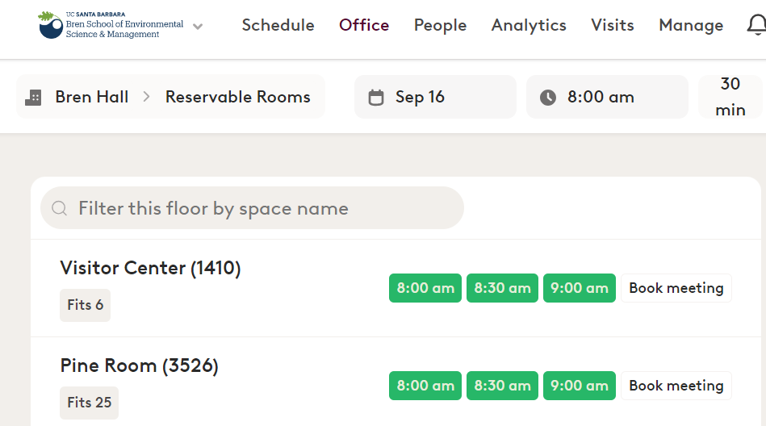
Meeting Space Reservations (Robin)
Online Interface For Booking:
Immediate Self Booking
Search For Available Spaces
UCSB Google Account Required
Limited to short, non-recurring reservations
Mobile App Available
For Advanced / Complex Room Needs:
Email: scheduling@bren.ucsb.edu
Speak with Bren Staff (Emily, Sean, Jamie)
booking.bren.ucsb.edu

Slide 9
Bren Desktop Account
Windows Domain account used to log into Bren computers and access certain resources.
Same username as your UCSBnetID
Different password than your UCSBnetID
Includes modest Bren Personal Drive (H:) for document storage
You can access your Bren Personal Drive (H:) and other network files through our REEF web portal located at: reef.bren.ucsb.edu

Slide 10
Printing and Equipment Loans
Printing:
Printers at Bren located in Student Mailroom
Can be printed to by either Bren Windows Lab PC, or by uploading document through web interface
How-to articles available at: bren.zendesk.com
Additional printing options at UCSB
Bren related or personal documents only
Equipment Loans:
We have laptops we can loan if you have a need
We have various webcams, headsets, mice, keyboards, monitors etc. available for students to use if needed
Email compute@bren.ucsb.edu or stop by zoom / our offices to chat about your needs

Slide 11
Printing Pricing / Locations
Bren Printers: Located in Student Mailroom
Oreo (Black and White) - $0.03 per side
Crow (Black and White) - $0.03 per side
Kingfisher (Color) - $0.20 per side
Bren Printers: Located in Small SCF (Afterhours)
Penguin (Black and White) - $0.03 per side
Included Print Funds
$30 per year included for free, no refunds
$200 can be distributed during Group Project

Slide 12
Computing Lab Spaces
Computing Spaces
Commons: 9 PC’s, 4 Standup Laptop Stations, 3 Laptop Stations
GIS: 37 PC’s
SCF Small: 13 PC’s, 1 Collaborative Space
SCF Large: 6 Collaborative Spaces
Quiet Spaces
3rd Floor Library: Collaborative Space
1st Floor Library: 8 Large Laptop Stations

Slide 13
Remote Access
Remote Lab Compute Access
Instructions: bren.zendesk.com
Requires VPN
General Access, and Reserved GP Pools of Computers
Remote File Access
Website: reef.bren.ucsb.edu
UCSB Cloud Storage (Box / Google)

Slide 14
Cloud and Bren Personal Drive Storage
Cloud: Geographically Dispersed, Accessed Through Internet
UCSB Google Drive (20GB) – personal / shared / collaborative folders https://drive.google.com
Box (15GB) – another cloud storage https://ucsb.box.com
Bren Personal Drive (H:): On File Server In Bren Building
Limited storage intended for documents (10-20gb total)
Should not be used for data sets
Additional storage for scratch / data sets and how to access will be shared as part of your classes

Slide 15
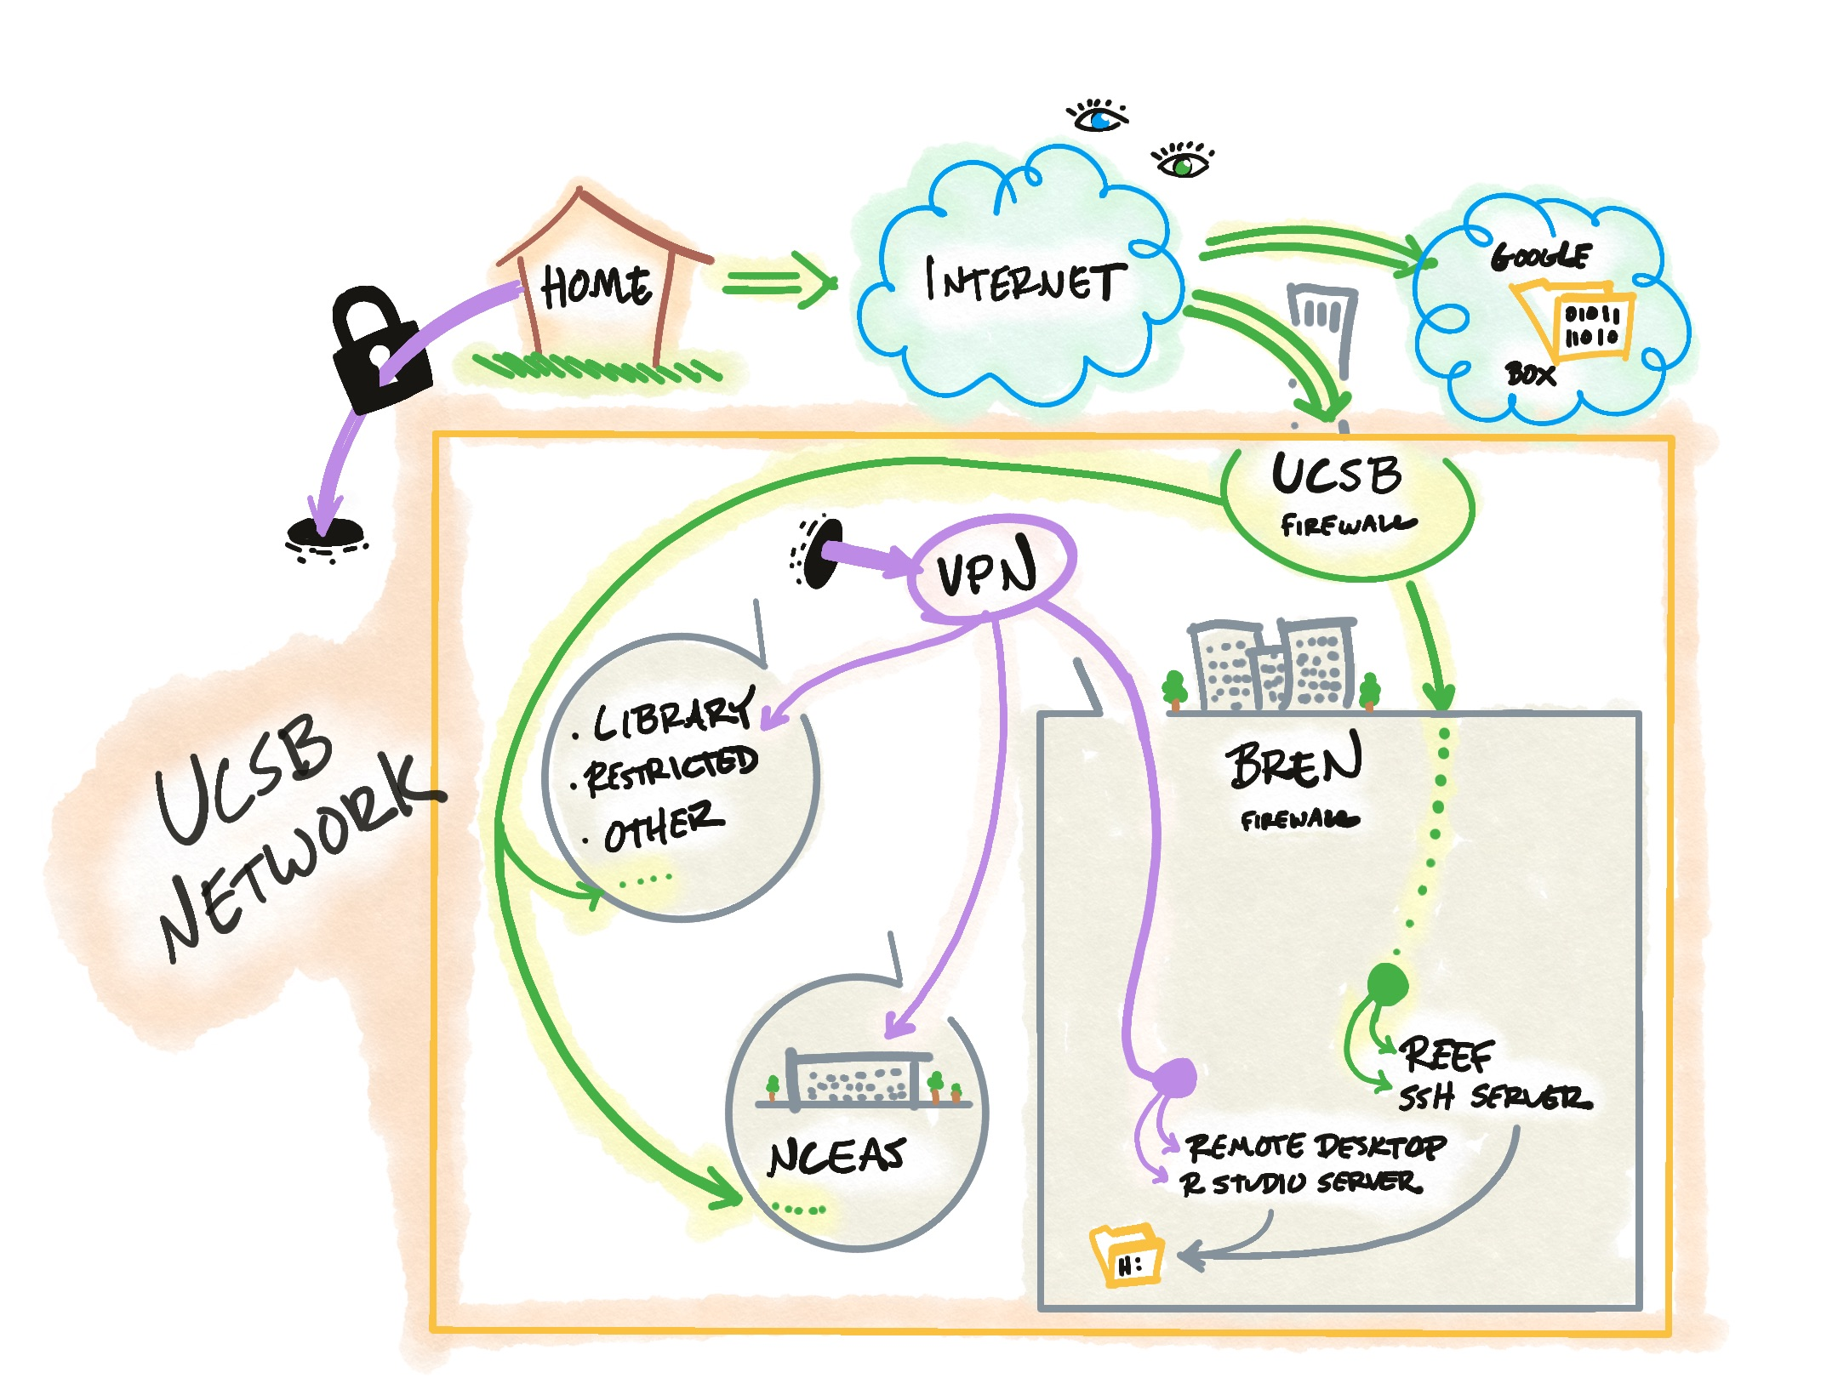
UCSB VPN
Encrypts your internet traffic to UCSB
Makes your computer part of UCSB network
Required to access some resources
Does not affect Zoom performance

Slide 16
Microsoft Office for Students
As a student you can download and install Microsoft office
bit.ly/ucsbdownloadoffice
Google Drive let’s you use Sheets, Docs etc.
UCSB’s Box service also have Office365 integration
Does not include OneDrive access

Slide 17
Getting Help
Email: compute@bren.ucsb.edu
Office Hours (via Zoom) Tuesday and Fridays from 2:30 - 3:30 pm PST ( Join meeting 847-4349-7043 )
Bren Compute Team Knowledgebase: bren.zendesk.com * we’ll also post presentation here

